Slide 1
MATH221 Mathematics for Computer Science
Unit 5
Relations and Functions

Slide 2
OBJECTIVES
Understand what is a relation and function.
Determine the domain and range of relation and function.
Evaluate the properties of relation such as reflexivity, symmetry and transitivity.
Understand what is a function, one-to-one and onto function
Find the existence of inverse function.

Slide 3
Unit 5a
Relations

Slide 4
Cartesian Product
Given two sets A and B, the Cartesian product of A and B, denoted by A × B (read “A cross B”), is the set of all ordered pairs (a, b), where a is in A and b is in B.
Symbolically,
A × B = {(a, b): a ∈ A and b ∈ B}

Slide 5
Cartesian Product: Example
Let A = {x, y}, B = {1, 2, 3}, C = {a, b}. Find the followings.
a. A × B b. (A × B) × C
a. A × B = {(x, 1), (x, 2), (x, 3), (y, 1), (y, 2), (y, 3)}
b. (A × B) × C = {(u, v): u ∈ A × B and v ∈ C}
= {((x, 1), a), ((x, 2), a), ((x, 3), a), ((y, 1), a), ((y, 2), a), ((y, 3), a), ((x, 1), b), ((x, 2), b), ((x, 3), b), ((y, 1), b), ((y, 2), b), ((y, 3), b)}

Slide 6
Relations
Let A and B be sets. We say that R is a (binary) relation from A to B if R ⊆ A × B.
If R ⊆ A × A, we will say that R is a relation on A.
Further, if (a, b) ∈ R, we will frequently write aRb and say that “a is related to b by R”, symbolically, denoted as aRb.

Slide 7
Discussion:
Consider the relation R on ℝ given by
R = {(x, y): x, y ∈ ℝ ∧ x = y}.
(i) We can sketch a graph of this relation as follows:
y
y = x
x

Slide 8
Discussion:
(ii) True of False? 1R1
True
1.1111R1.1111 and (1.1111, 1.1111) ∈ R
True
2.1R2.2
False
(-3, 3) ∈ R
False

Slide 9
Relations: Notes
The relation in the previous discussion is usually written as
R = {(x, x): x ∈ ℝ}
and it is normally called the identity relation on ℝ.

Slide 10
Examples:
1. Let X = {0, 1, 2, 3} and let the relation R on X be given by R = {(x, y): ∃z ∈ ℕ, x + z = y}.
(i) List all the elements of R.
R = {(0, 1), (0, 2), (0, 3), (1, 2), (1, 3), (2, 3)}

Slide 11
Examples:
(ii) Sketch X × X and circle the elements of R.
y
3
2
1
0
1
2
3
x

Slide 12
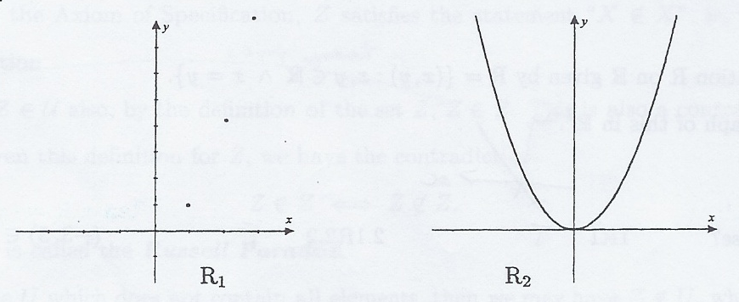
Examples
2. Let R₁ be the relation on ℕ given by R₁ = {(x, y): y = x²}.
Let R₂ be the relation on ℝ given by R₂ = {(x, y): y = x²}. By sketching each relation, we can see how the “input set” makes a difference to the elements in the relation

Slide 13
Example:
Let A = {0, 1} and B = {-1, 0, 1}. Let two relations from A to B be given by
R₁ = {(0, -1), (1, -1), (1, 0)},
and R₂ = {(0, 0), (1, 1), (1, -1)}.
Write down R₁ ∩ R₂ and R₁ ∪ R₂.
R₁ ∩ R₂ = {(1, -1)}
R₁ ∪ R₂ = {(0, -1), (0, 0), (1, -1), (1, 0), (1, 1)}.

Slide 14
Domain and Range of Relations
Let R be a relation from A to B.
Then the domain of R, denoted by Dom R, is given by
Dom R = {x: ∃y, xRy}
and the range of R, denoted Range R, is given by
Range R = {y: ∃x, xRy}

Slide 15
Examples:
1. Let A = {0, 1, 2, 3} and let R be a relation on A given by R₁ = {(0, 0), (0, 1), (0, 2), (3, 0)}.
Write down Dom R₁ and Range R₁.
Dom R₁ = {0, 3}
Range R₁ = {0, 1, 2}
2. Let R₂ be the relation on ℤ given by R₂ = {(x, y): xy ≠ 0}.
What are Dom R₂ and Range R₂.
Dom R₂ = ℤ - {0}
Range R₂ = ℤ - {0}

Slide 16
Domain and Range of Relations: Notes
1. Let R be a relation from A to B. Then Dom R ⊆ A and Range R ⊆ B.
2. We could say that Dom R is the set of all first elements in the ordered pairs that belong to R.
Range R is the set of all second elements in the ordered pairs that belong to R.

Slide 17
Inverse Relations
S
Let R be a relation from A to B.
We define the inverse relation, R⁻¹, from B to A as
R⁻¹ = {(y, x): (x, y) ∈ R}.

Slide 18
Inverse Relations: Example
S
Consider the relation R from A = {a, b, c} to B = {1, 2, 3, 4}.
R = {(a, 1), (b, 2), (c, 3), (a, 4)}.
The inverse relation, R⁻¹, is simply each ordered pair written “in reverse”.
R⁻¹ = {(1, a), (2, b), (3, c), (4, a)}.

Slide 19
Inverse Relations: Example
S
2. Define a relation R on ℕ as R = {(x, y): y = 2x}.
(i) Write down three elements of R. Write down three elements of R⁻¹.
Three elements of R : (1, 2), (2, 4), (3, 6)
Three elements of R⁻¹ : (2, 1), (4, 2), (6, 3)

Slide 20
Inverse Relations: Example
S
2. (ii) Sketch a graph of R and R⁻¹ on coordinate axes.
y
4
R
3
2
R⁻¹
1
0
1
2
3
4
x

Slide 21
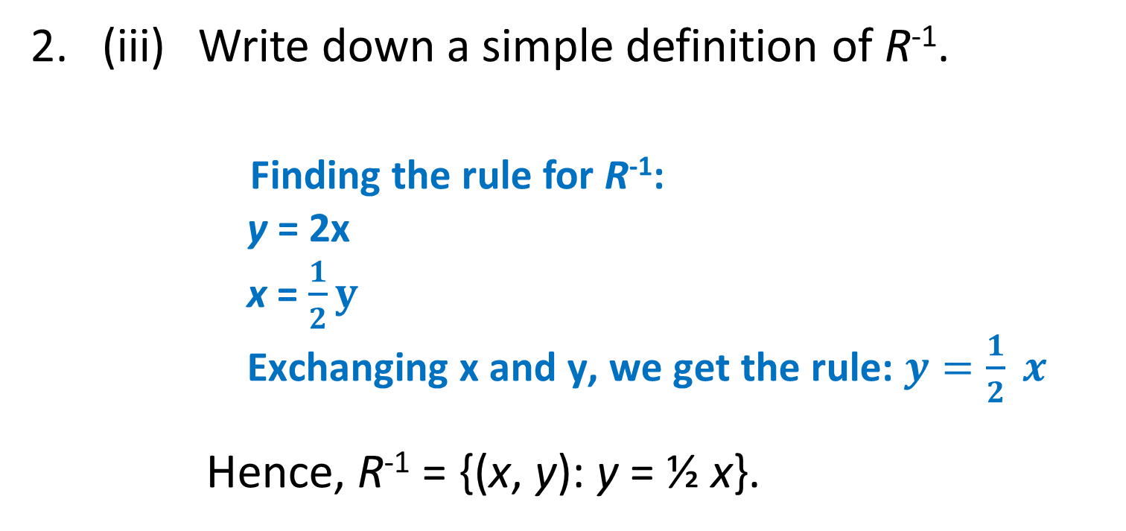
Examples:
S
2. (iii) Write down a simple definition of R⁻¹.
Finding the rule for R⁻¹:
y = 2x
x = $\frac{1}{2}y$
Exchanging x and y, we get the rule: $y=\frac{1}{2} x$
Hence, R⁻¹ = {(x, y): y = ½ x}.

Slide 22
Reflexivity
Let R be a relation on the set A.
R is reflexive on A if and only if ∀x ∈ A, (x, x) ∈ R.

Slide 23
Reflexivity: Example 1 and 2 (Relations listed out directly)
Example 1: Let B1 = {s, t} and let R1 be the relation on B1 given by
R1 = {(s, s), (t, t)}.
Verification/Proof:
Verifying each x ∈ B1 as follows:
s ∈ B1: (s, s) ∈ R1
t ∈ B1: (t, t) ∈ R1
So, the statement, ∀x ∈ B1, (x, x) ∈ R1, is true.
Hence, R1 is reflexive.
Example 2: Let B2 = {s, t, u} and let R2 be the relation on B2 given by
R2= {(s, s), (t, t)}.
Verification/Proof:
Verifying each x ∈ B2 as follows:
s ∈ B2: (s, s) ∈ R2
t ∈ B2: (t, t) ∈ R2
u ∈ B2: But, (u, u) ∉ R2
So, the statement, ∀x ∈ B2, (x, x) ∈ R2, is false.
Hence, R2 is not reflexive.

Slide 24
Reflexivity: Example 3 (Relation defined using set builder notation)
Let R₁ be a relation on ℕ defined by
R₁ = {(x, y): x is a factor of y}.
For each x ∈ ℕ, x = 1⋅x.
Hence, x is a factor of itself.
Thus, (x, x) ∈ R₁ and so R₁ is reflexive.
Informally, a relation R on a set A is reflexive if each element in A is related to itself by R.

Slide 25
Symmetry
Let R be a relation on the set A.
R is symmetric on A if and only if
∀x, y ∈ A, ((x, y) ∈ R ⇒ (y, x) ∈ R).

Slide 26
Symmetry: Example 1 and 2 (Relations listed out directly)
Example 1: Let B3 = {s, t} and let R3 be the relation on B3 given by
R3 = {(s, s), (t, t)}.
Verification/Proof:
Verifying each x, y ∈ B3 with (x, y) ∈ R3 as follows:
s, s ∈ B3 with (s, s) ∈ R3: (s, s) ∈ R3
t, t ∈ B3 with (t, t) ∈ R3: (t, t) ∈ R3
So, the statement, ∀x, y ∈ B3 such that (x, y) ∈ R3 implies (y, x) ∈ R3, is true.
Hence R3 is symmetric.
Example 2: Let B4 = {s, t, u} and let R4 be the relation on B4 given by
R4 = {(s, s), (t, t), (t, u)}.
Verification/Proof:
Verifying each x, y ∈ B4 with (x, y) ∈ B4 as follows:
s, s ∈ B4 with (s, s) ∈ R4: (s, s) ∈ R4
t, t ∈ B4 with (t, t) ∈ R4: (t, t) ∈ R4
t, u ∈ B4 with (t, u) ∈ R4: But, (u, t) ∉ R4
So, the statement, ∀x, y ∈ B4 such that (x, y) ∈ R4 implies (y, x) ∈ R4, is false.
Hence R4 is not symmetric.

Slide 27
Symmetry: Example 3 (Relation defined using set builder notation)
Let R₂ be a relation on ℤ given by
R₂ = {(a, b): ab ≠ 0}.
∀a, b ∈ ℤ, if (a, b) ∈ R₂, then ab ≠ 0.
This implies that ba ≠ 0.
Thus, then (b, a) ∈ R₂.
Hence, R₂ is symmetric.
Informally, a relation R on a set A is symmetric if you can “swap” the elements in ordered pairs in R around and still get ordered pairs in R.

Slide 28
Transitivity
Let R be a relation on the set A.
R is transitive on A if and only if
∀x, y, z ∈ A, ((x, y) ∈ R ∧ (y, z) ∈ R) ⇒ (x, z) ∈ R).

Slide 29
Transitivity: Example 1 and 2 (Relations listed out directly)
Example 1: Let B5 = {s, t, u} and let R5 be the relation on B5 given by
R5 = {(s, s), (t, t)}.
Verification/Proof:
Verifying each x, y, z∈ B5 with (x, y) ∈ R5 and (y, z) ∈ R5 as follows:
Since there is no x, y, z∈ B5 with (x, y) ∈ R5 and (y, z) ∈ R5, there is nothing to check.
So, the statement, ∀ x, y, z∈ B5 such that (x, y) ∈ R5 and (y, z) ∈ R5 implies (x, z) ∈ R5, is satisfied (no violation of this predicate on R5) .
Hence R5 is transitive.
Example 2: Let B6 = {s, t, u} and let R6 be the relation on B6 given by
R6 = {(s, s), (t, t), (t, u), (u, t)}.
Verification/Proof:
Verifying each x, y, z∈ B6 with (x, y) ∈ R6 and (y, z) ∈ R6 as follows:
t, u, t∈ B6 with (t, u) ∈ R6 and (u, t) ∈ R6: (t, t) ∈ R6
t, t, u∈ B6 with (t, t) ∈ R6 and (t, u) ∈ R6: (t, u) ∈ R6
u, u, t∈ B6 with (u, t) ∈ R6 and (t, u) ∈ R6: But (u, u) ∉ R6
So, the statement, ∀ x, y, z∈ B6 such that (x, y) ∈ R6 and (y, z) ∈ R6 implies (x, y) ∈ R6, is false.
Hence R6 is not transitive.

Slide 30
Transitivity: Example 3 (Relation defined using set builder notation)
Let R₃ be the relation on ℤ defined by
R₃ = {(x, y): x < y}.
Let (x, y) ∈ R₃ and (y, z) ∈ R₃. Since (x, y) ∈ R₃, x < y. Since (y, z) ∈ R₃ , y < z. This implies that x < z. Hence, (x, z) ∈ R₃. Therefore, R₃ is transitive.

Slide 31
Equivalence Relations
Let R be a relation on the set A.
R is an equivalence relation on A if and only if R is reflexive, symmetric and transitive on A.

Slide 32
Equivalence Relation: Example
1. Let R₁ be a identity relation on ℝ. Then R₁ is an equivalence relation.
Proof:
Reflexive: ∀a ∈ ℝ, a = a, that is, (a, a) ∈ R₁.
Thus, R₁ is reflexive.
Symmetric: ∀a, b ∈ ℝ, if (a, b) ∈ R₁, then a = b.
Thus, b = a, and hence, (b, a) ∈ R₁.
Hence, R₁ is symmetric.
Transitive:
∀a, b, c ∈ ℝ, if (a, b) ∈ R₁ and (b, c) ∈ R₁, then a = b and b = c. Thus, a = c, and hence (a, c) ∈ R₁.
Therefore, R₁ is transitive.
Therefore, R₁ is an equivalence relation.
Note:
Identity Relation:
R = {(x, x): x ∈ ℝ}

Slide 33
Non-Equivalence Relation: Example
2. Let R₂ be the relation on ℤ given by
R₂ = {(a, b): ab ≠ 0}.
Reflexive: We must show ∀a ∈ ℤ, a × a ≠ 0.
But, we note that 0 ∈ ℤ and 0 × 0 = 0.
Hence, (0, 0) ∉ R₂ .
Therefore, R₂ is NOT reflexive.
Therefore, R₂ is not an equivalence relation.

Slide 34
Discussion:
S
Consider the relation R₂ on ℤ given by
R₂ = {(a, b): ab ≠ 0}.
(i) Is R₂ symmetric or transitive?
Symmetric:
∀a, b ∈ ℤ, if (a, b) ∈ R₂, then ab ≠ 0.
This implies that ba ≠ 0.
Thus, then (b, a) ∈ R₂.
Hence, R₂ is symmetric.
Transitive:
∀ a, b, c ∈ ℤ, if (a, b) ∈ R₂ and (b, c) ∈ R₂, then ab ≠ 0 and bc ≠ 0.
This implies that ac ≠ 0.
Thus, (a, c) ∈ R₂.
Hence, R₂ is transitive.

Slide 35
Discussion:
S
(ii) How can we adjust the relation so that it becomes and equivalence relation?
Adjust ℤ to ℤ - {0}.

Slide 36
Equivalence Relations: Notes
1. To prove a relation R is an equivalence relation, you must prove all three properties.
2. To disprove that a relation R is an equivalence relation, you must show that one of the three properties does not hold, usually by counterexample.

Slide 37
Equivalence Relations: Example
S
Let A = {0, 1, 2} and let R be the relation on A given by
R = {(0, 0), (1, 1), (2, 2), (0, 1), (1, 0)}.
Prove R is an equivalence relation on A.
Reflexive: For a = 0: (0, 0) ∈ R.
For a = 1: (1, 1) ∈ R.
For a = 2: (2, 2) ∈ R.
So, ∀a ∈ A, (a, a) ∈ R.
Thus, R is reflexive.

Slide 38
Equivalence Relations: Example
S
Symmetric: We must check each ordered pair (a, b) ∈ R to see if (b, a) is also in the relation.
For (0, 0), (1, 1), (2, 2) symmetry obviously holds.
For (0, 1), we need to check that (1, 0) ∈ R, which it is.
For (1, 0), we need to check that (0, 1) ∈ R, which it is
Thus, R is symmetric.

Slide 39
Equivalence Relations: Example
S
Transitive:
We must check each pair of elements (a, b), (b, c) ∈ R that (a, c) ∈ R.
(0, 0), (0, 1) ∈ R, so (0, 1) should be in R, which it is.
(1, 1), (1, 0) ∈ R, so (1, 0) should be in R, which it is.
(0, 1), (1, 1) ∈ R, so (0, 1) should be in R, which it is.
(0, 1), (1, 0) ∈ R, so (0, 0) should be in R, which it is.
(1, 0), (0, 1) ∈ R, so (1, 1) should be in R, which it is.
(1, 0), (0, 0) ∈ R, so (1, 0) should be in R, which it is.
Thus, R is transitive.
Therefore, R is an equivalence relations.

Slide 40
Equivalence Class
Let R be an equivalence relation on the set A.
Then for each a ∈ A, we define the equivalence class of a as
Class(a) = {b ∈ A: (a, b) ∈ R}.

Slide 41
Equivalence Class: Example
Let A = {0, 1, 2}. Consider the following relation R on A in the previous example.
R = {(0, 0), (1, 1), (2, 2), (0, 1), (1, 0)}.
For each element in a, we write the equivalence classes as follows:
Class(0) = {b ∈ A: (0, b) ∈ R} = {0, 1}
Class(1) = {b ∈ A: (1, b) ∈ R} = {1, 0} = class(0)
Class(2) = {b ∈ A: (2, b) ∈ R} = {2}

Slide 42
Unit 5b
Functions

Slide 43
Functions
If F is a relation from A to B, then we say F is a function from A to B, if and only if
1) Dom F = A.
2) For each element x ∈ A, there is only one value y ∈ B such that (x, y) ∈ F.
We say that B is the codomain of F.
The set {y: ∃x ∈ A, (x, y) ∈ F } is called the range of F.

Slide 44
Functions: Note
As convenient, we will now change to the more familiar function notation. We write
f: A → B,
to indicate that f is a function from A to B, and we write
y = f(x)
to mean exactly the same thing as (x, y) ∈ f.
In this case, we may say that y is the image of x under f.
44

Slide 45
Proving/Disproving/Justifying Function for Relation F from A to B
Finite cases?
For 1st property, find Dom F directly, and compare Dom F with A to conclude.
For 2nd property, check whether is there any x ∈ A such that xFy₁ and xFy₂ and y₁ ≠ y₂. If no, the property is satisfied.
Infinite cases?
For 1st property, we need to prove A ⊆ Dom F ( because of Dom F ⊆ A).
For 2nd property, we need to prove the following:
∀x₁, x₂ ∈ A, if (x₁, y₁), (x₂, y₂) ∈ F such that x₁ = x₂, then y₁ = y₂
Note:
For infinite cases, the 2nd Property can be checked by Vertical line test also (will be explained later with example).

Slide 46
Finite Case: Examples
Let A = {2, 4, 6} and let B = {1, 3, 5}. Consider the following relations from A to B.
1. R₁ = {(x, y): x + 1 = y} = {(2, 3), (4, 5)}.
Dom R₁ = {2, 4} ≠ A.
Thus, R₁ is not a function.
2. R₂ ={(2, 5), (4, 1), (4, 5), (6, 5)}.
Dom R₂ = {2, 4, 6} = A.
However, 4 is related to both 1 and 5.
Thus R₂ is not a function.
Finite cases (relation F from A to B)?
For 1st property, find Dom F directly, and compare Dom F with A to conclude.
For 2nd property, check whether is there any x ∈ A such that xRy₁ and xRy₂ and y₁ ≠ y₂. If no, the property is satisfied.

Slide 47
Example: Function
Show that R₁ on ℝ defined by R₁ = {(x, y): y = x²} is a function.
Infinite cases (relation F from A to B)?
For 1st property, we need to prove A ⊆ Dom F (Since Dom F ⊆ A is always true, this implies Dom F = A).
For 2nd property, we need to prove the following:
∀x₁, x₂ ∈ A, if (x₁, y₁), (x₂, y₂) ∈ F such that x₁ = x₂, then y₁ = y₂
Proof:
(1) Let x ∈ ℝ, from the definition of R_{1,}(x, x²)∈ R₁.
This implies that x ∈ Dom R₁.
Thus, ℝ ⊆ Dom R₁.
Hence, the 1st property of function is satisfied.
Let (x₁, y₁), (x₂, y₂) ∈ R₁ such that x₁ = x₂.
Then, y₁ = x₁² = x₂² = y₂.
Hence, the 2nd property of function is satisfied.
Therefore R₁, is a function.

Slide 48
Example: Non-Function (Violating the 1st Property)
Show that R₂ on ℝ defined by R₂ = {(x, y): x = y²} is not a function as it violates the first property.
Infinite cases? (relation F from A to B)
For 1st property, we need to disprove A ⊆ Dom F
Proof:
Take x = -1 ∈ ℝ .
Since y² is always nonnegative, there is no y ∈ ℝ such that -1 = y² ∈ ℝ.
Hence, there is no y ∈ ℝ such that (-1, y) ∈ R₂
Thus, -1 ∉ Dom R₂.
Hence, ℝ is not a subset of Dom R₂.
Therefore, R₂ is not a function as it violates the 1st property.

Slide 49
Example: Non-Function (Violating the 2nd Property)
Show that R₂ on ℝ defined by R₂ = {(x, y): x = y²} is not a function as it violates the second property.
Infinite cases(relation F from A to B)?
For 2nd property, we need to disprove the following:
∀x₁, x₂ ∈ A, if (x₁, y₁), (x₂, y₂) ∈ F such that x₁ = x₂, then y₁ = y₂
Proof:
Take x₁ = 4 ∈ ℝ and y₁ = 2 ∈ ℝ.
Since x₁ = 4 = 2² = y₁ ², from definition of R₂, (4, 2) ∈ R_{2.}
Likewise, take x₂ = 4 ∈ ℝ and y₂ = -2 ∈ ℝ.
Since x₂ = 4 = (-2)² = y₂ ², from definition of R₂, (4, -2) ∈ R_{2.}
Hence, we have (4, 2), (4, -2) ∈ R₂ such that 4 = 4, but 2 ≠ -2.
Therefore, R₂ is not a function as it violates the 2nd property.

Slide 50
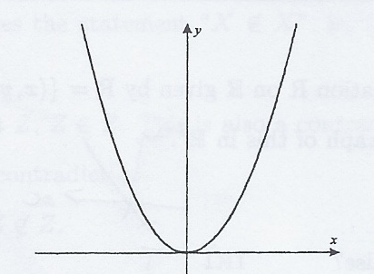
Example: Checking 2nd Property Using Vertical Line Test
Show that R₁ on ℝ defined by R₁ = {(x, y): y = x²} satisfies the 2nd Property of function.
Draw the graph of the relation.
Check whether if a vertical line always cut the graph by one point only: If yes, it satisfies, otherwise, not satisfies.
Since the vertical line always cuts the graph by one point only, R₁ satisfies the 2nd property of function.

Slide 51
One-To-One Functions
Let f: A → B be a function. f is one-to-one if and only if
∀x₁, x₂ ∈ A, (f(x₁) = f(x₂) ⇒ x₁ = x₂).

Slide 52
Proving/Disproving/Justifying One-To-One Function (f: A → B)
Finite cases?
We check whether there are x1, x2 ∈ A such that x1 ≠ x2 and f(x1) = f(x2). If no, the property is satisfied. Hence, f is one-to-one.
Infinite Cases?
We need to prove the following:
∀x₁, x₂ ∈ A, if f(x₁) = f(x₂), then x₁ = x₂
Note:
For infinite cases, it can also be checked by Horizontal line test also (will be explained later with example).

Slide 53
Finite Cases: Example
Finite cases (f: A → B) ?
We check whether there are x1, x2 ∈ A such that x1 ≠ x2 and f(x1) = f(x2). If no, the property is satisfied. Hence, f is one-to-one.
Which of the following are one-to-one functions?
(i) F₁ on A = {1, 2, 3}, F₁ = {(1, 2), (2, 3), (3, 1)}.
No two different elements in A are related to the same element in F₁.
Hence, F₁ is a one-to-one function.
(ii) F₂ on A = {1, 2, 3}, F₂ = {(1, 2), (2, 1), (3, 1)}.
No, since both 2 and 3 have the same image 1.

Slide 54
Example: One-To-One Function
Let f: ℤ → ℤ be a function, defined as f(x) = 2x. Show that f is a one-to-one function.
Infinite Cases (f: A → B) ?
We need to prove the following:
∀x₁, x₂ ∈ A, if f(x₁) = f(x₂), then x₁ = x₂
Proof:
Let x_{1 ,} x₂∈ ℤ such that f(x₁) = f(x₂).
Since f(x₁) = f(x₂), 2x₁ = 2x₂.
This implies x₁ = x_{2.}
Therefore, f is one-to-one

Slide 55
Example: Not One-To-One
Let f: ℝ → ℝ, defined as f(x) = x². Show that f is not a one-to-one function.
Infinite Cases (f: A → B)?
We need to disprove the following:
∀x₁, x₂ ∈ A, if f(x₁) = f(x₂), then x₁ = x₂
Proof:
Take x₁ = 3 ∈ ℝ and x₂ = -3 ∈ ℝ
Then, f(x₁) = f(3) = 3² = 9 and f(x₂) = f(-3) = (-3)² = 9 .
Hence, f(3) = f(-3) = 9.
But, 3 ≠ -3.
Therefore, f is not one-to-one.

Slide 56
Example: Checking One-To-One Using Horizontal Line Test
Show that F on ℝ defined by F = {(x, y): y = x²} is not a one-to-one function.
Draw the graph of the function.
Check whether if a horizontal line always cuts the graph by one point only: If yes, then it is one-to-one, otherwise, it is not.
Since the horizontal line cuts the graph by multiple points, F is not a one-to-one function.

Slide 57
Onto Functions
Let f: A → B be a function.
f is onto if and only if
Range f = B,
that is,
∀y ∈ B, ∃x ∈ A, y = f(x).

Slide 58
Proving/Disproving/Justifying Onto Function (f: A → B)
Finite cases?
Find Range R directly. If Range f = B, then f is onto, otherwise, f is not onto.
Infinite cases?
We need to prove the following:
∀y ∈ B, ∃x ∈ A, y = f(x)
or Range f = B
How to find x ∈ A for the proof?
From y = f(x) solve x in terms of y.

Slide 59
Finite Cases: Example
Finite cases (f: A → B)
Find Range R directly. If Range f = B, then f is onto, otherwise, f is not onto.
Determine which of the following functions are onto.
Let A = {1, 2, 3, 4, 5} and B ={a, b, c, d}.
(i) f₁: A → B, f₁ = {(1, a), (2, c), (3, c), (4, d), (5, d)}
Since range f₁ = {a, c, d} ≠ B, hence, f₁ is not onto.
(ii) f₂: A → B, f₂ = {(1, a), (2, b), (3, c), (4, d), (5, a)}
Yes, since range f₂ = {a, b, c, d} = B.

Slide 60
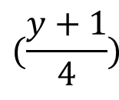
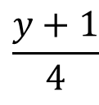
Example: OnTo
Infinite cases (f: A → B)?
We need to prove the following:
∀y ∈ B, ∃x ∈ A, y = f(x)
Let f₃: ℝ → ℝ be a function defined as f₃(x) = 4x -1. Show that f₃ is a onto function.
Proof:
Let y ∈ ℝ.
Take x = ∈ ℝ.
Then, f₃(x) = 4⋅ - 1
= (y + 1) -1 = y
Hence, y = f₃(x).
Therefore, f₃ is onto
Note
Why take x = (y+1)/4?
(solve x in terms of y)
y = f₃(x) = 4x -1
4x = y + 1
x = (y+1)/4
Clearly x = (y+1)/4 ∈ ℝ
$$\frac{y+1}{4}$$
$$(\frac{y+1}{4})$$

Slide 61

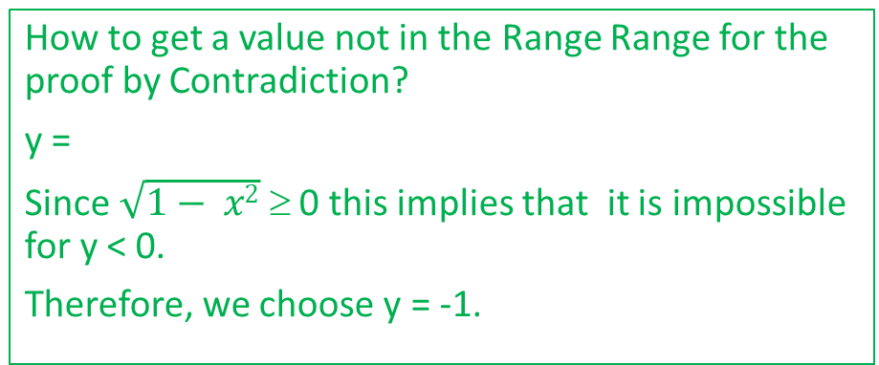



Example: Not OnTo
Infinite cases (f: A → B)?
We need to disprove the following:
∀y ∈ B, ∃x ∈ A, y = f(x)
or Range f = B
Let A = {x ∈ ℝ: -1 ≤ x ≤ 1} and F be a function from A to A defined as F(x) = . Show that F is not onto.
$$\sqrt{1−x^{2 }}$$
We shall use Proof by Contradiction to show that f is not onto. Justification/Proof of Not Onto:
Suppose that f is onto.
Then, Range f = A .
Since -1 ∈ A, -1 ∈ Range f.
Hence, there is a x ∈ A such that F(x) = -1.
This implies that = -1.
Since ≥ 0, this is a contradiction.
Therefore, F is not onto.
How to get a value not in the Range Range for the proof by Contradiction?
y =
Since $\sqrt{1− x2}$ ≥ 0 this implies that it is impossible for y < 0.
Therefore, we choose y = -1.
$$\sqrt{1−x^{2 }}$$
$$\sqrt{1−x^{2 }}$$
$$\sqrt{1−x^{2 }}$$

Slide 62
Inverse Functions
S
For any function, there is an inverse relation, however, this inverse relation is not always a function.
The inverse relation of F will also be a function when F is one-to-one and onto. In this case, we call the inverse relation of F the inverse function of F.

Slide 63
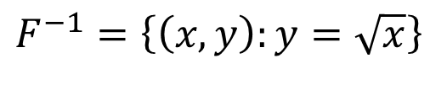
Example: Finding Inverse Function
S
Sketch the function F from A = {x ∈ ℝ: x ≥ 0} to A given by
F = {(x, y): y = x²}.
Sketch F⁻¹. Find F⁻¹.
Is F⁻¹ a function?
y
F
1
F⁻¹
$$F^{−1}=\left\{\left(x,y\right):y=\sqrt{x}\right\}$$
0
1
x
F⁻¹ is a function since F is one-to-one and onto.
Note: Finding rule for inverse function:
y = x ²
x = $\sqrt{y}$ (from algebra and x ∈ A)
Exchanging x and y, we get the rule: $y=\sqrt{x}$

Slide 64
End of Unit 5

